Slide 1
Social Science
Class
HARIHARAN

Slide 2
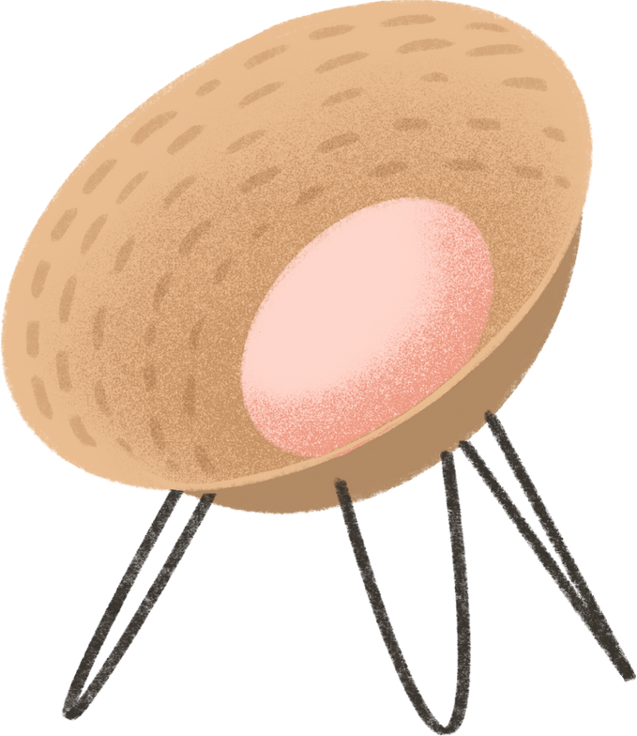
Hi, students!
How r u all?

Slide 4
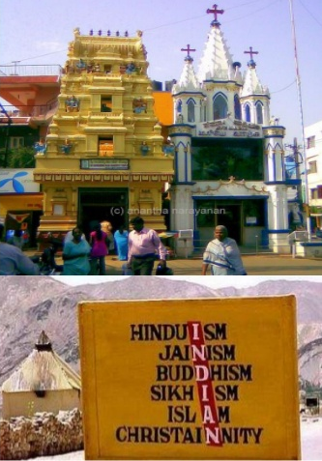
UNITY
IN
DIVERSITY
WHAT IS UNITY IN DIVERSITY ?
Unity in diversity means oneness in the varieties.
Unity in diversity focuses on the existence of unity even After lots of differences of cultural, social, linguistic, religious, political,
ideological, psychological, etc.

Slide 5
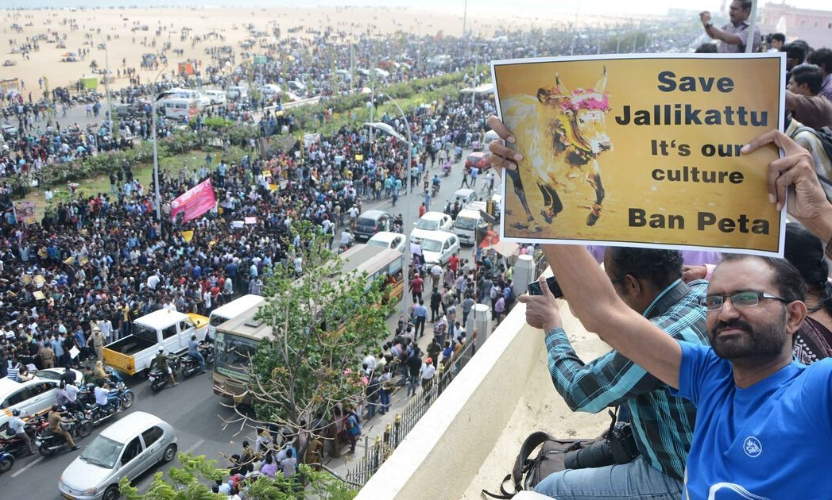
Example

Slide 6
Culture
idea
beliefs
customs
art
religions
music and
dance
food habits
festivals

Slide 7
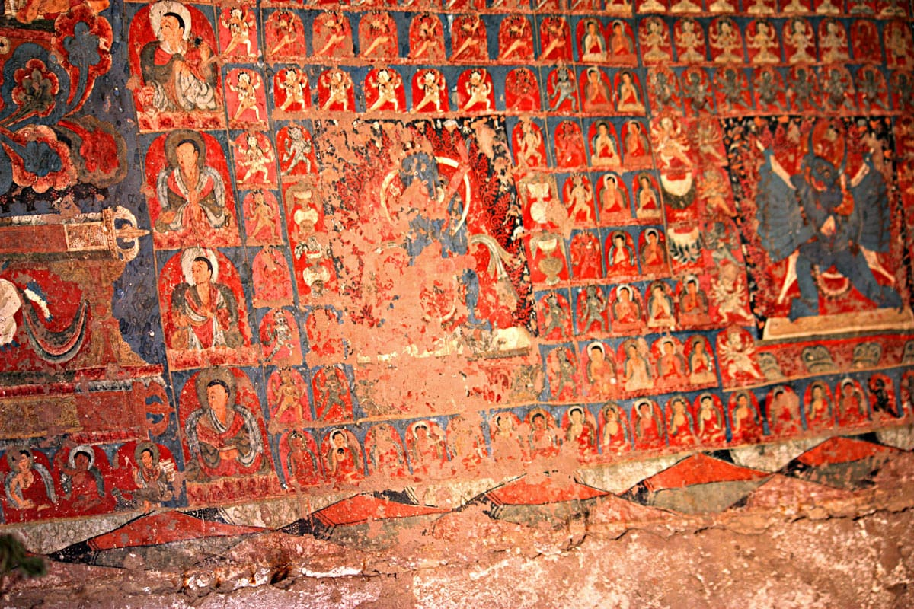
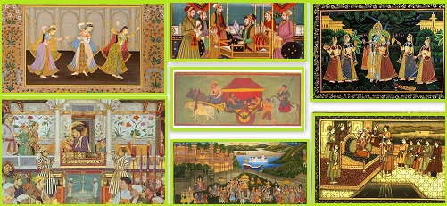
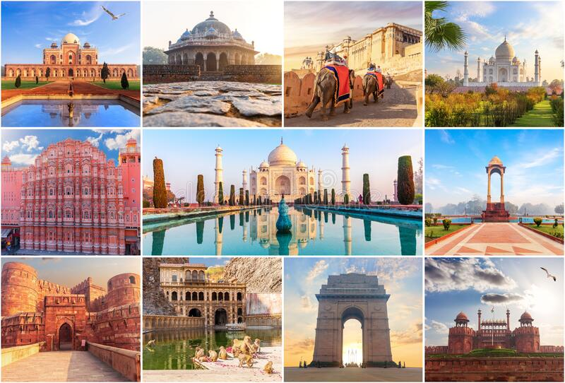
Art and sculpture
Indian art consists of a variety of art forms, including painting ,sculpture , pottery , and textile arts such as woven silk.
The ancient Indian masons and craftsmen produced wonderful works of art, starting from Harappan times.
In the historical period, the monolithic pillars erected by Ashoka are famous for their gloss and polish, which match the gloss on Northern Black Polished Ware.
It is still a mystery how the craftsmen were able to achieve this kind of polish on pillars and pottery.

Slide 8
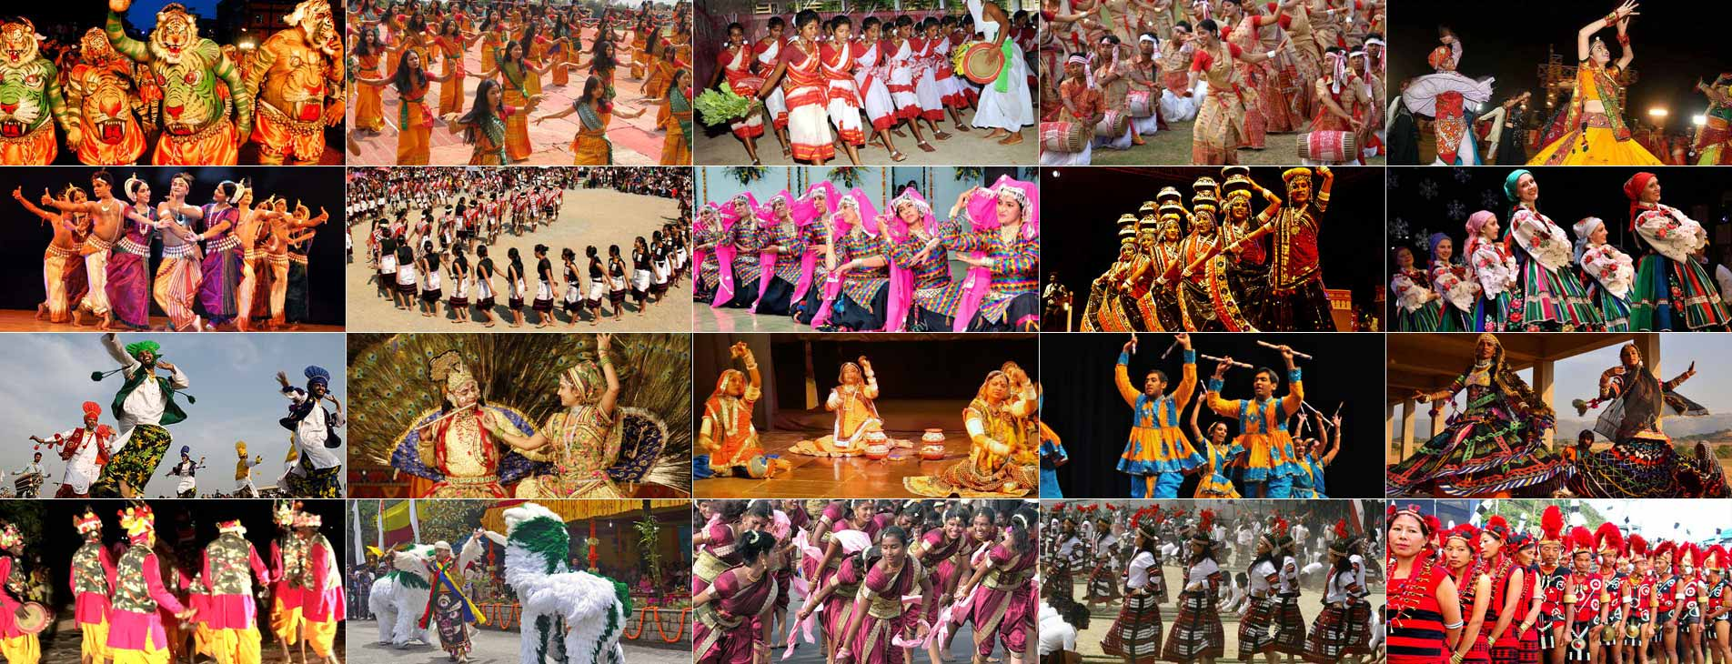
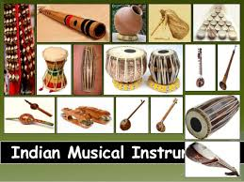
DANCE AND MUSIC
INDIA HAS TWO MAJOR DANCES
THEY ARE CLASSICAL ,FOLK ,
INDIA HAS EN-NUMBER OF MUSIC
QAWWALI , FOLK ,GHAZAL,CLASSICAL

Slide 9
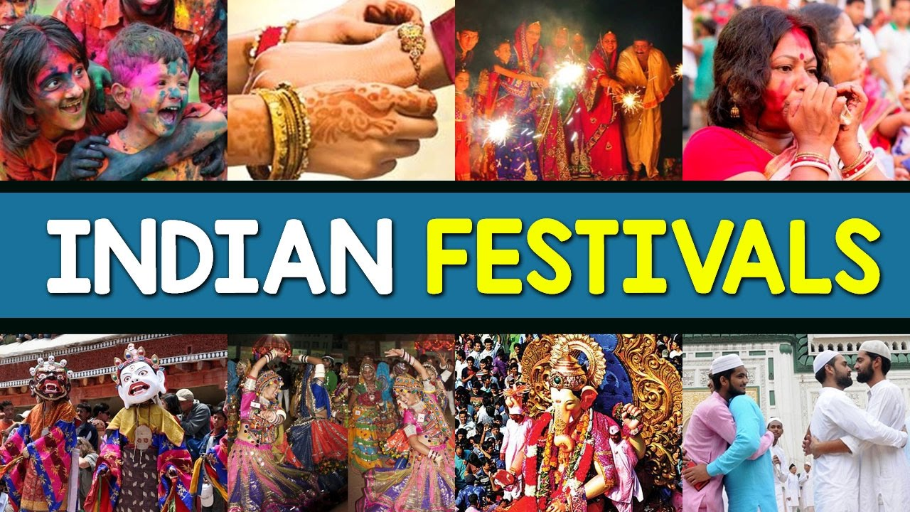
FESTIVALS
IN OUR COUNTRY THERE
ARE MANY FESTIVALS HAS BEEN CELEBRATE. AND ALSO THERE
WILL BE A DIFFERENT
LIFE STYLE FOR EACH
RELIGION.

Slide 10
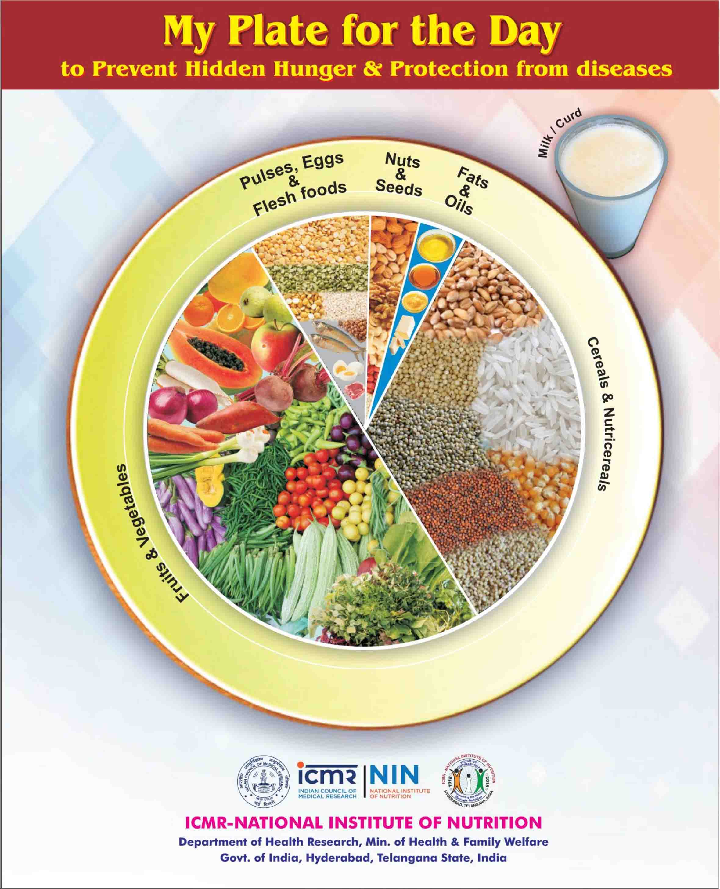
Indian Food

Slide 11
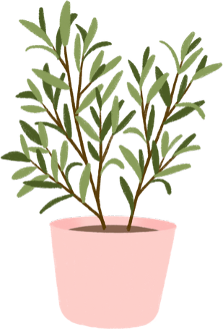
Thank you

